Slide 1
DATA SCIENCE BOOTCAMP
Session 2: Data Science Methodology and Python Syntax
Copyright © 2020 Exceed Philippines. All rights reserved

Slide 2
SESSION 2 OUTLINE
DATA SCIENCE METHODOLOGY
PYTHON SYNTAX
Copyright © 2020 Exceed Philippines. All rights reserved

Slide 3
SESSION 2 OUTLINE
DATA SCIENCE METHODOLOGY
PYTHON SYNTAX
Copyright © 2020 Exceed Philippines. All rights reserved

Slide 4
Business Understanding
Data Mining
Data Cleaning
Data Exploration
Feature Engineering
Predictive Modeling
Data Visualization
DATA SCIENCE
LIFE CYCLE
Copyright © 2020 Exceed Philippines. All rights reserved
Notes:
7 PHASES

Slide 5
DATA SCIENCE ROLES
Machine Learning Engineer
Data Engineer
Data Scientist
Key Technical Skills
ETL/ELT Development (Informatica, Talend, Python)
Data Management (SQL, Spark, Hadoop)
Data Orchestration (Python, platform-specific services)
Data Pipeline Deployment, Monitoring & Maintenance
Business Intelligence and Data Visualization (Tableau, Power BI, Qlik)
Key Technical Skills
Statistical Programming/Data Mining (R, Python)
Machine Learning (R, Python)
Model Deployment, Monitoring & Maintenance
Key Technical Skills
Statistical Programming/Data Mining (R, Python)
Machine Learning (R, Python)
Statistics, Applied Mathematics
Copyright © 2020 Exceed Philippines. All rights reserved
Notes:
Data Engineer: A software engineer who integrates data from various sources, orchestrates data workflows & pipelines using data management practices, and provisions the data for different usage.
ML Engineer: A software engineer who creates, trains and tests the actual ML model and operationalizes it in an environment that includes evaluation and monitoring.
Data Scientist: An expert in extracting knowledge and insights from structured and unstructured data using domain knowledge, specialized techniques such as machine learning or statistical programming, and programming language such as Python or R.

Slide 6
DATA SCIENCE PROCESS
DATA ENGINEERING
COLLABORATION
ML DEVELOPMENT
Copyright © 2020 Exceed Philippines. All rights reserved

Slide 7
1
BUSINESS UNDERSTANDING
Business Understanding
Data Mining
Data Cleaning
Data Exploration
Feature Engineering
Predictive Modeling
Data Visualization
Ensures that every decision made is supported by concrete data and that it is guaranteed (with a high probability) to achieve results.
DATA SCIENCE
LIFE CYCLE
DATA ENGINEERING
COLLABORATION
ML DEVELOPMENT
Copyright © 2020 Exceed Philippines. All rights reserved
Notes:
Critical that we understand the problem we are trying to solve.
Stage of asking why’s.
Use Case: How Might We Recommend To Decide Priority of Tickets

Slide 8
1
DATA MINING
Business Understanding
Data Mining
Data Cleaning
Data Exploration
Feature Engineering
Predictive Modeling
Data Visualization
2
Data mining is the process of gathering data from different sources.
DATA SCIENCE
LIFE CYCLE
DATA ENGINEERING
COLLABORATION
ML DEVELOPMENT
Copyright © 2020 Exceed Philippines. All rights reserved
Notes:
In this stage, some of the questions worth considering are — what data do we need for our project? Where does it live? How can we obtain it? What is the most efficient way to store and access all of it?
Current: Direct SNOW extracts

Slide 9
1
DATA CLEANING
Business Understanding
Data Mining
Data Cleaning
Data Exploration
Feature Engineering
Predictive Modeling
Data Visualization
Most time-consuming step of all.
2
DATA SCIENCE
LIFE CYCLE
3
DATA ENGINEERING
COLLABORATION
ML DEVELOPMENT
Copyright © 2020 Exceed Philippines. All rights reserved
Notes:
According to interviews with data scientists, this process (also referred to as ‘data janitor work’) can often take 50 to 80 percent of their time.
Expectation:
The data could have inconsistencies within the same column, meaning that some rows could be labeled 0 or 1, and others could be labeled no or yes.
The data types could also be inconsistent — some of the 0s might integers, whereas some of them could be strings.
If we’re dealing with a categorical data type with multiple categories, some of the categories could be misspelled or have different cases, such as having categories for both male and Male. (Maria or Ma.)
Missing data can throw a lot of errors in the Machine learning model creation and training

Slide 10
1
DATA EXPLORATION
Business Understanding
Data Mining
Data Cleaning
Data Exploration
Feature Engineering
Predictive Modeling
Data Visualization
2
This stage is like the brainstorming of data analysis.
DATA SCIENCE
LIFE CYCLE
3
DATA ENGINEERING
4
COLLABORATION
ML DEVELOPMENT
Copyright © 2020 Exceed Philippines. All rights reserved
Notes:
Explores the story behind the outliers.
Forms hypotheses about your data and the problem you are tackling.
Expectation:
Confirmation and discussion with data usage

Slide 11
1
FEATURE ENGINEERING
Business Understanding
Data Mining
Data Cleaning
Data Exploration
Feature Engineering
Predictive Modeling
Data Visualization
2
In machine learning, a feature is a measurable property or attribute of a phenomenon being observed.
Two tasks: Feature selection and Feature engineering
DATA SCIENCE
LIFE CYCLE
3
DATA ENGINEERING
5
4
COLLABORATION
ML DEVELOPMENT
Copyright © 2020 Exceed Philippines. All rights reserved
Notes:
Expectation:
Feature Selection
Cutting down features that add more noise than information.
Note: Complexity because of many features
Feature Construction
Creates new features from the ones that we already have (and possibly ditching the old ones)
Figure out which features contribute best to the accuracy of the model

Slide 12
1
PREDICTIVE MODELING
Business Understanding
Data Mining
Data Cleaning
Data Exploration
Feature Engineering
Predictive Modeling
Data Visualization
2
This is where machine learning finally comes into the project.
DATA SCIENCE
LIFE CYCLE
6
3
DATA ENGINEERING
5
4
COLLABORATION
ML DEVELOPMENT
Copyright © 2020 Exceed Philippines. All rights reserved
Notes:
The model being trained will be dependent on the size, type and quality of the data, how much time and computational resources are willing to invest, and the type of output intended to be derived.
Expectation:
Build and train different machine learning model and check the accuracy.
Produce results based on a metric for visualization consumption.

Slide 13
1
DATA VISUALIZATION
Business Understanding
Data Mining
Data Cleaning
Data Exploration
Feature Engineering
Predictive Modeling
Data Visualization
7
2
This is where we derived the intended insights from the model.
DATA SCIENCE
LIFE CYCLE
6
3
DATA ENGINEERING
5
4
COLLABORATION
ML DEVELOPMENT
Copyright © 2020 Exceed Philippines. All rights reserved
Notes:
The main objective is to present the results in a way that the different key stakeholders in the project can understand.
Expectation:
Tableau Visualization; Presentation of model’s prediction

Slide 14
8
1
BUSINESS UNDERSTANDING
Business Understanding
Data Mining
Data Cleaning
Data Exploration
Feature Engineering
Predictive Modeling
Data Visualization
7
2
This is where we evaluate the success of the model if it relates to the original business understanding.
DATA SCIENCE
LIFE CYCLE
6
3
DATA ENGINEERING
5
4
COLLABORATION
ML DEVELOPMENT
Copyright © 2020 Exceed Philippines. All rights reserved
Notes:
In this stage, some of the questions worth considering are — Does it tackle the problems identified? Does the analysis yield any tangible solutions?
Expectation:
Working model that shows results right

Slide 15
PROJECT MANAGEMENT
Copyright © 2020 Exceed Philippines. All rights reserved

Slide 16
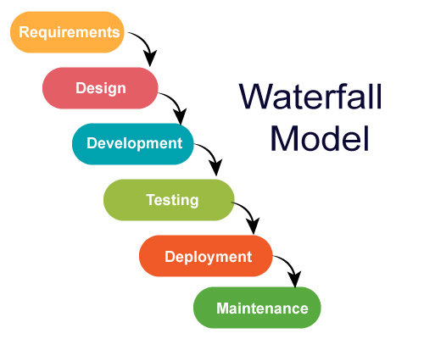
Copyright © 2020 Exceed Philippines. All rights reserved

Slide 17
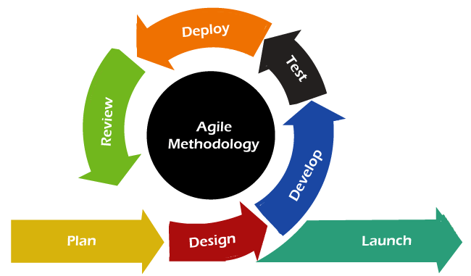
Copyright © 2020 Exceed Philippines. All rights reserved

Slide 18
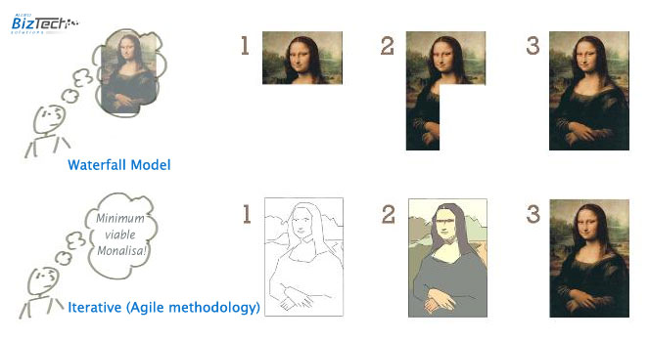
AGILE VS WATERFALL
Copyright © 2020 Exceed Philippines. All rights reserved

Slide 19
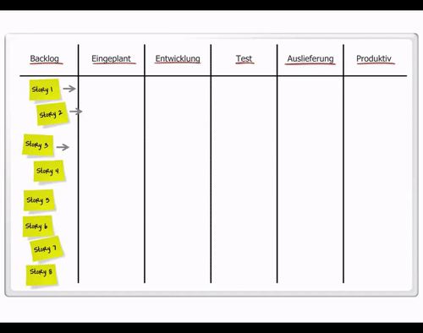
AGILE USING KANBAN
Copyright © 2020 Exceed Philippines. All rights reserved

Slide 20



HIGH LEVEL PROCESS
MACHINE LEARNING
DATA CONSUMPTION
DATA SOURCE
Copyright © 2020 Exceed Philippines. All rights reserved

Slide 21

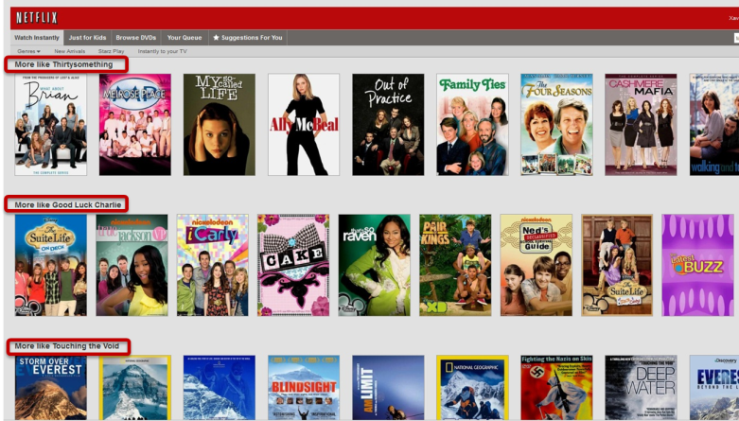
HIGH LEVEL PROCESS EXAMPLE
MACHINE LEARNING
DATA CONSUMPTION
DATA SOURCE
Viewing History | Actors
Ratings | Release Year
Title | Time of Day Watched
Genre | Devices
Categories | How Long You Watch
COLLABORATIVE FILTERING
CONTENT-BASED FILTERING
Copyright © 2020 Exceed Philippines. All rights reserved

Slide 22




MARK
COLLABORATIVE FILTERING
RECOMMENDATION:
KATE
WHATIS.TECHTARGET.COM
Copyright © 2020 Exceed Philippines. All rights reserved
Notes:
Collaborative filtering uses algorithms to filter data from user reviews to make personalized recommendations for users with similar preferences

Slide 23

CONTENT-BASED
FILTERING
RECOMMENDATION:
KATE
DEVELOPERS.GOOGLE.COM
Copyright © 2020 Exceed Philippines. All rights reserved
Notes:
Content-based filtering uses item features to recommend other items similar to what the user likes, based on their previous actions or explicit feedback.

Slide 24
HIGH LEVEL PROCESS EXAMPLE
MACHINE LEARNING
DATA CONSUMPTION
DATA SOURCE
Viewing History | Actors
Ratings | Release Year
Title | Time of Day Watched
Genre | Devices
Categories | How Long You Watch
COLLABORATIVE FILTERING
CONTENT-BASED FILTERING
Copyright © 2020 Exceed Philippines. All rights reserved

Slide 25
DATA SCIENCE APPLICATIONS
Copyright © 2020 Exceed Philippines. All rights reserved

Slide 26
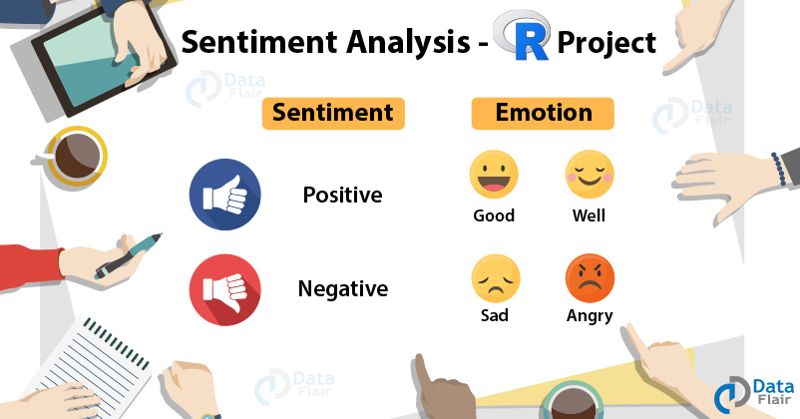
DATA-FLAIR.TRAINING
Copyright © 2020 Exceed Philippines. All rights reserved
Notes:
Sentiment analysis is the act of analyzing words to determine sentiments and opinions that may be positive or negative in polarity. This is a type of classification where the classes may be binary (positive and negative) or multiple (happy, angry, sad, disgusted,..)

Slide 27
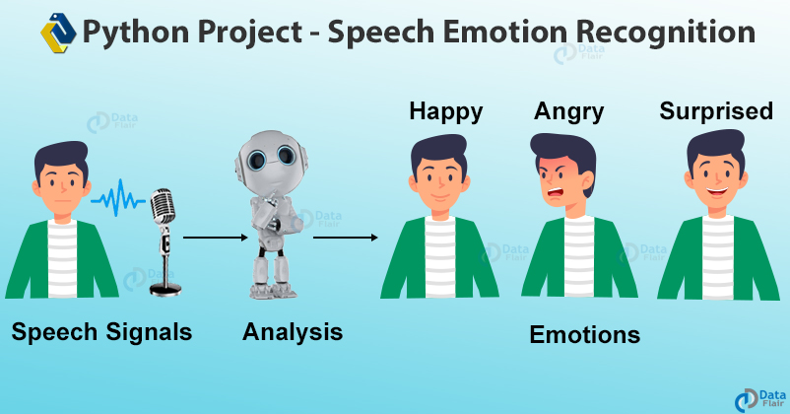
DATA-FLAIR.TRAINING
Copyright © 2020 Exceed Philippines. All rights reserved
Notes:
This data science project uses librosa (LIBRARY) to perform Speech Emotion Recognition. SER is the process of trying to recognize human emotion and affective states from speech. Since we use tone and pitch to express emotion through voice, SER is possible

Slide 28
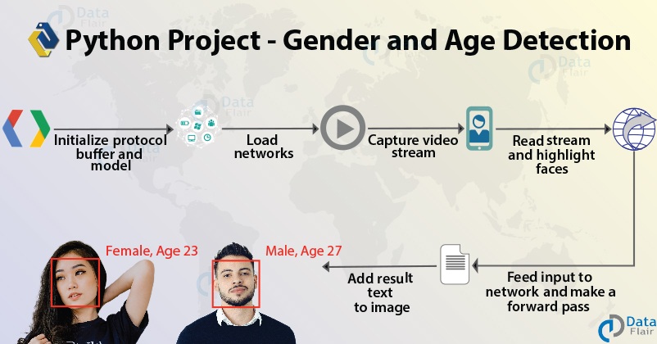
DATA-FLAIR.TRAINING
Copyright © 2020 Exceed Philippines. All rights reserved
Notes:
Using just one image, you’ll learn to predict the gender and age range of an individual. In this, we introduce you to Computer Vision and its principles.

Slide 29
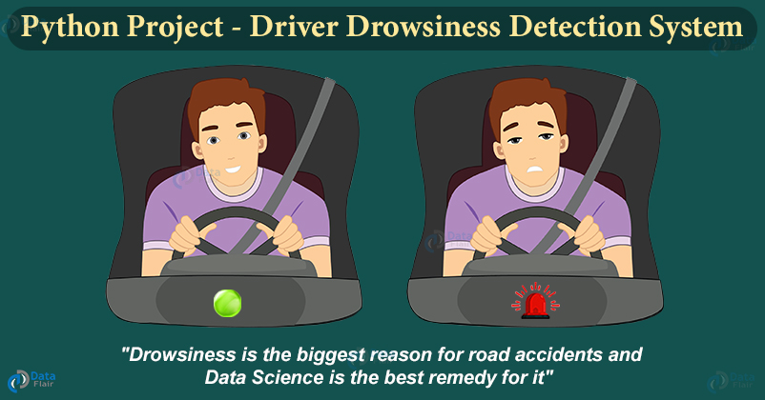
DATA-FLAIR.TRAINING
Copyright © 2020 Exceed Philippines. All rights reserved
Notes:
Drowsy driving is extremely dangerous and around thousands of accidents happen each year due to drivers falling asleep while driving. In this Python project, we will build a system that can detect sleepy drivers and also alert them by beeping alarm.
CLASSIFY the state of the eye (Open or Close) using Deep neural network techniques.

Slide 30
DATA SCIENCE IN DIFFERENT INDUSTRIES
Copyright © 2020 Exceed Philippines. All rights reserved

Slide 31
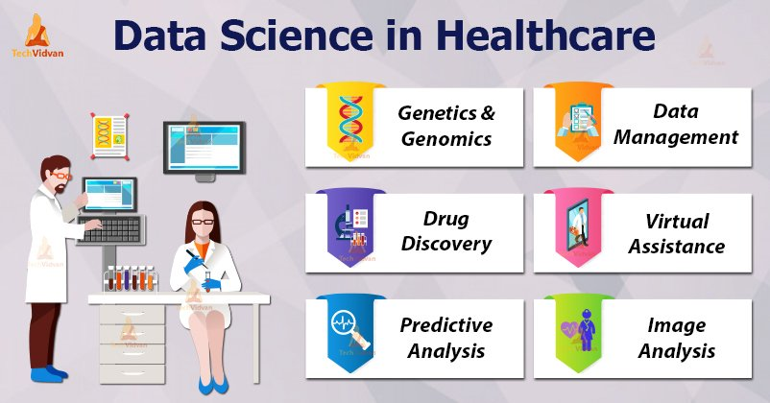
GOOGLE IMAGES: “DATA SCIENCE MEDICINE”
Copyright © 2020 Exceed Philippines. All rights reserved

Slide 32
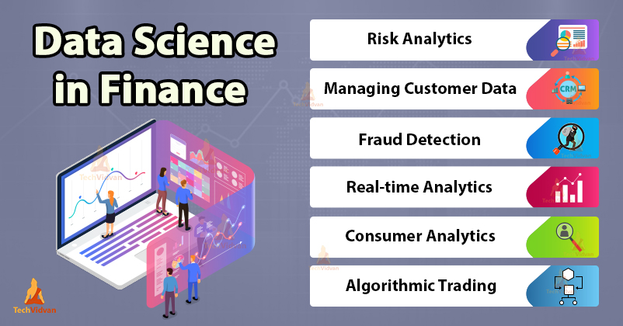
GOOGLE IMAGES: “DATA SCIENCE FINANCE”
Copyright © 2020 Exceed Philippines. All rights reserved

Slide 33
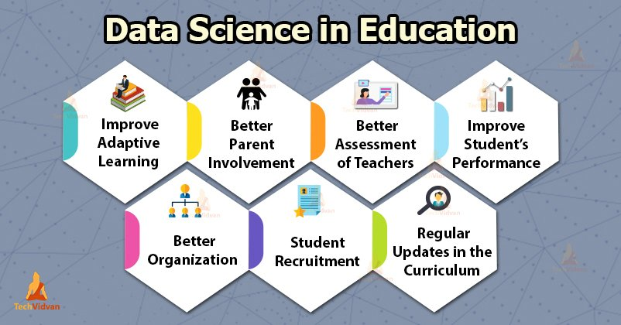
GOOGLE IMAGES: “DATA SCIENCE EDUCATION”
Copyright © 2020 Exceed Philippines. All rights reserved

Slide 34
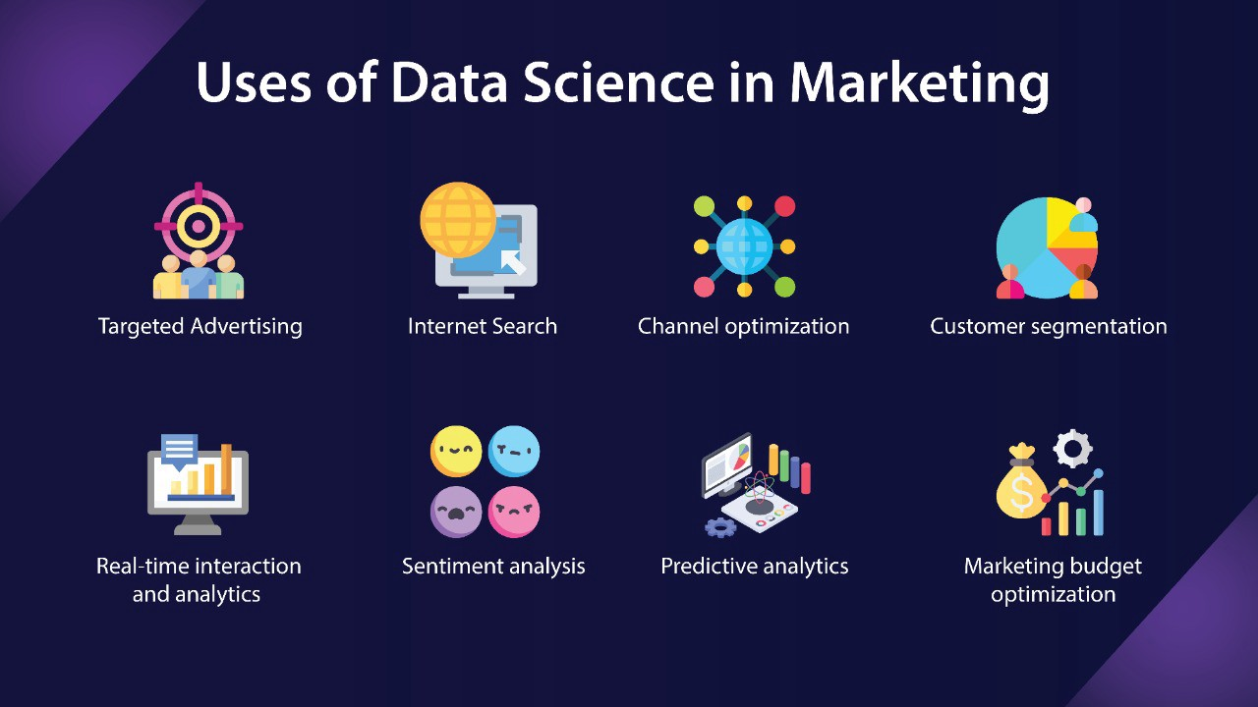
GOOGLE IMAGES: “DATA SCIENCE MARKETING”
Copyright © 2020 Exceed Philippines. All rights reserved

Slide 35
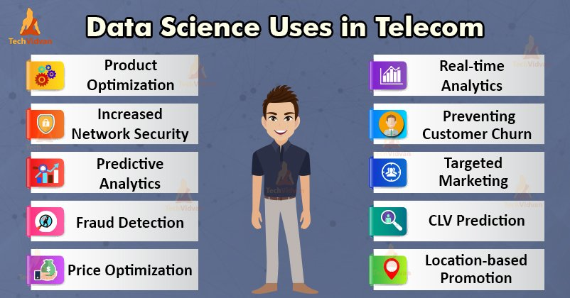
GOOGLE IMAGES: “DATA SCIENCE TELCO”
Copyright © 2020 Exceed Philippines. All rights reserved

Slide 36
SESSION 2 OUTLINE
DATA SCIENCE METHODOLOGY
PYTHON SYNTAX
Copyright © 2020 Exceed Philippines. All rights reserved

Slide 37
CARE AND SHARE!
Copyright © 2020 Exceed Philippines. All rights reserved

Slide 38
DATA SCIENCE BOOTCAMP
Session 2: Data Science Methodology and Python Syntax
Copyright © 2020 Exceed Philippines. All rights reserved

